Slide 1
MOVIE RECOMMENDATION SYSTEM
PRESENTED BY
- MADHUBASHINI.S
- KOWSALYA.S

Slide 2
ABSTRACT:
Finding information on a large web site can be a difficult and time-consuming process. Recommender systems can help users find information by providing them with personalized suggestions.
To solve this, a movie recommendation system is used, which incorporates
1. Content-Based Filtering Algorithm
2. Long Short Term Memory (LSTM) Algorithm
A movie recommendation system suggests movies to users based on their preferences or similar users' tastes. It enhances user engagement, helps discover new content, and improves the overall viewing experience.
In this study, we evaluate the performance of the movie recommendation system using key metrics such as confusion matrix, precision, recall, and accuracy. These metrics help assess the system's ability to correctly recommend relevant movies while minimizing errors and optimizing user experience.

Slide 3
INTRODUCTION:
In today’s digital world, recommendation systems have become a cornerstone of personalized user experiences, particularly in entertainment platforms like movie streaming services. The primary goal of this project is to design an intelligent movie recommendation system that enhances user engagement by providing tailored suggestions.
Algorithms used in the proposed system:
Content-Based Filtering:-
Content-based filtering is a recommendation system technique that suggests items based on the features of the items and a user's preferences. It uses a profile of the user's preferences to recommend items similar to those the user has liked or interacted with in the past.
Example: If a user likes action movies, the system recommends other action movies based on genres, keywords, or descriptions.

Slide 4
Algorithms used in the proposed system:
LSTM Algorithm:-
LSTM (Long Short-Term Memory) is a type of recurrent neural network (RNN) designed to handle sequential data and overcome the vanishing gradient problem.
It is particularly effective in tasks involving time-series data, natural language processing, and sequence prediction.
Example Use Case:
Predicting the next word in a sentence or stock price forecasting based on historical data.

Slide 5
LITERATURE SURVEY TABLE:
S.NO | AUTHOR(S) | YEAR | TITLE | PROS AND CONS
1. | Robin van Meteren and Maarten van Someren | 2018 | Content-Based Filtering for Recommendation | recommend personalized items based on the features. reduce the diversity of recommendations.
2. | Debangan Mandal, Rajarshi Biswas, Mohammad Aasim, Rutvik Ramteke, Piyush Drig, Manpreet Kaur | 2024 | Beyond the Hype : Building a Personalized Movie Experience with Content-Based Recommendation | more accurate and tailored suggestions. -consistently suggesting movies with very similar attributes, potentially overlooking broader or more varied user interests.

Slide 6
S.NO | AUTHOR(S) | YEAR | TITLE | PROS AND CONS
3. | Shashikala H.K, Praghnya Iyer K, Himaja K.R, Rahisha Pokharel | 2023 | Personalized Movie Recommendation System | offering insights into how user preferences can be leveraged to provide tailored movie suggestions, enhancing the viewing experience. One downside of the approach is the potential challenge of handling sparse user data, where limited user interaction can make it harder to provide meaningful recommendations, especially for new users (cold start problem).
4. | Jiang Zhang, Yufeng Wang , Zhiyuan Yuan, and Qun Jin | 2020 | Personalized Real-Time Movie Recommendation System: Practical Prototype and Evaluation | The system is efficient and responsive, adapting recommendations based on the user’s recent activity, which enhances user satisfaction less efficient for large-scale or resource-constrained environments.

Slide 7
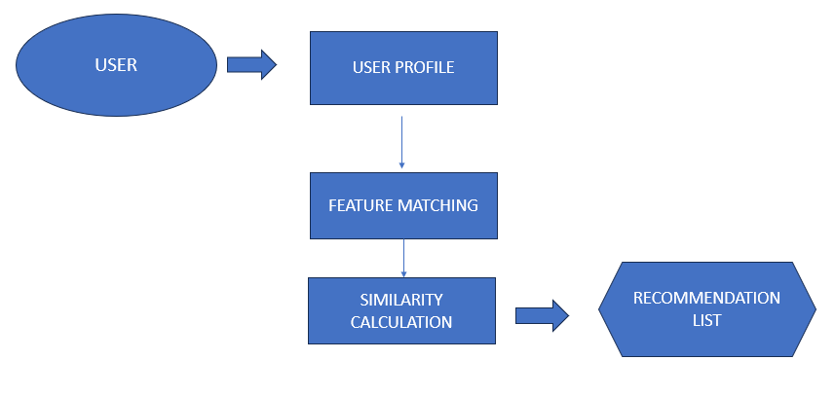
EXISTING WORK ARCHITECTURE

Slide 8
CONTENT- BASED FILTERING – EXISTING WORK
Content-based filtering recommends movies based on the features of the movies the user has liked.
It uses attributes like genre, director, cast, and description to find similar movies.
The algorithm analyzes user preferences and suggests items that share similar characteristics.
DRAWBACKS OF EXISTING SYSTEM
Cold Start Problem
Model Complexity
Limited Personalization
Lack of Real-Time Adaptation
Missed Collaborative Insights

Slide 9
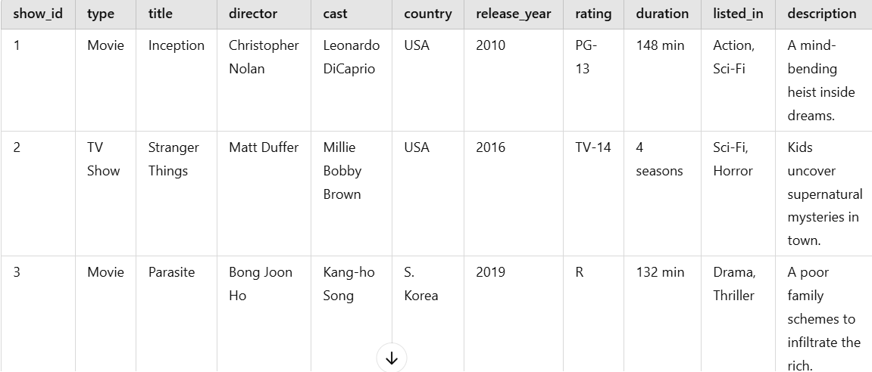
DATASET
.

Slide 10
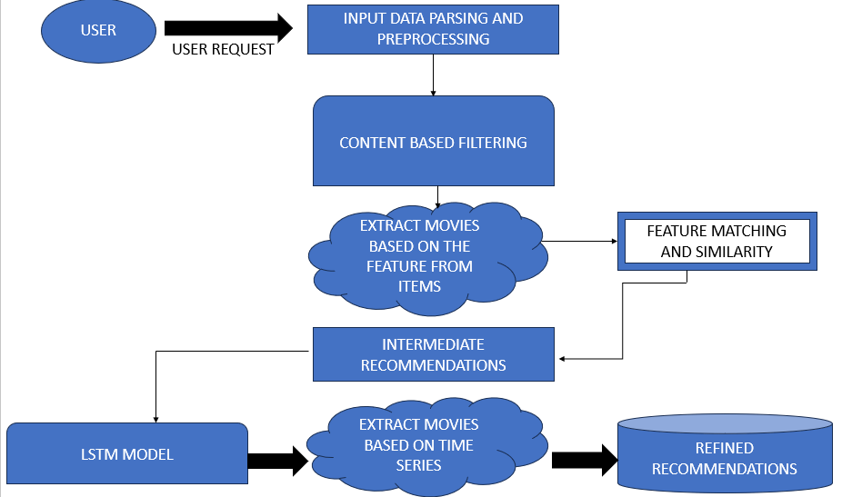
PROPOSED WORK ARCHITECTURE

Slide 11
LONG SHORT TERM MEMORY ALGORITHM- PROPOSED WORK
Long Short-Term Memory (LSTM) is a type of Recurrent Neural Network (RNN) that captures sequential data patterns.
It is effective in understanding temporal dependencies, such as user viewing history.-
LSTMs use memory cells to retain information over time, making them ideal for predicting user preferences based on movie-watching sequences.
MODULES IN PROPOSED WORK
Data Collection
Preprocessing the data
Content-Based Filtering
User Profile Construction
LSTM Model
Refined UserProfile Construction

Slide 12
ADVANTAGES OF PROPOSED WORK
Handling Sequential Data
Better Personalization
Overcoming Cold-Start Problem
Context Awareness
.

Slide 13
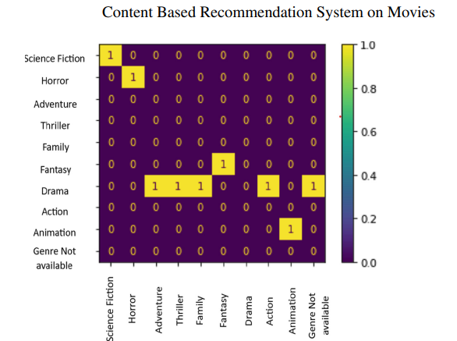
EVALUATION METRICS
1.Confusion Matrix:
A tabular representation of True Positives (TP), True Negatives (TN), False Positives (FP), and False Negatives (FN).
Helps in understanding the classifier's performance for each class.
.

Slide 14
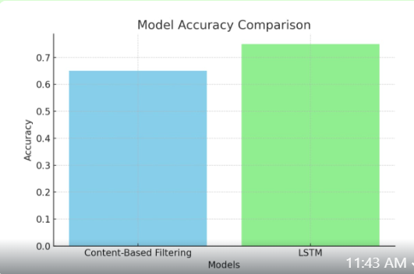
2.Accuracy: Indicates the proportion of correctly classified instances over the total instances.
.

Slide 15
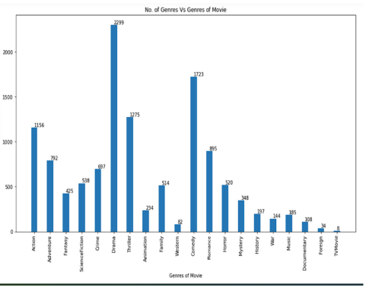
3.Precision: Measures the number of true positive predictions compared to the total positive predictions.
4.Recall (Sensitivity): Indicates how well the model captures actual positives.
5.F1-Score: A harmonic mean of precision and recall, used for imbalanced datasets.
Different Genres Of Movies In a Dataset

Slide 16
CONCLUSION
The movie recommendation system effectively combines Content-Based Filtering and LSTM algorithms to deliver accurate and personalized suggestions.
Content-Based Filtering provides recommendations by analyzing movie attributes and aligning them with user preferences, while LSTM leverages sequential data to capture patterns in user behavior over time.
Together, these approaches create a dynamic and efficient recommendation system, enhancing user satisfaction and engagement by delivering tailored movie choices.
This hybrid solution demonstrates the power of combining traditional and deep learning techniques in building intelligent systems.

Slide 17
FUTURE WORK
Incorporating the Transformer Algorithm in the Movie Recommendation System
In the future, the project will incorporate the Transformer algorithm to further enhance recommendation accuracy.
Transformers, known for their ability to process sequential data efficiently, can capture complex relationships and user preferences across large datasets.
This addition will improve the system's scalability and provide more precise, context-aware movie recommendations.

Slide 18
REFERENCES
1. Wang, H., Lou, N., & Chao, Z. (2020). A personalized movie recommendation system based on LSTM-CNN. In 2020 2nd International Conference on Machine Learning, Big Data and Business Intelligence (MLBDBI) (pp. 485–490).
https://doi.org/10.1109/MLBDBI51377.2020.00102
2. Fanca, A., Puscasiu, A., Gota, D.-I., & Valean, H. (2020). Recommendation systems with machine learning. In 2020 21st International Carpathian Control Conference(ICCC) (pp. 1–6).https://doi.org/10.1109/ICCC49264.2020.9257290
3. Lund, J., & Ng, Y.-K. (2018). Movie recommendations using the deep learning approach. In 2018 IEEE International Conference on Information Reuse and Integration (IRI) (pp. 47–54).https://doi.org/10.1109/IRI.2018.00015

Slide 19
THANK YOU

